Slide 1
How to support your child at home
Year 5 and 6
Mr Dalton
5 and 6 Phase Leader
2024-25

Slide 2
Aims
To give you some ideas of ways to support / develop further learning at home.
To emphasise the importance of working as a team (child, parent/carer and teacher).

Slide 3
What we will cover in this presentation
Year 5 and 6
Reading
Writing
Spelling
Maths
Behaviour/Expectations – “The Wavendon Gate Way”
Homework

Slide 4
Year 5 and 6
5A – Miss Postawa
5B – Mrs Carter
TA – Miss Deria
6A – Mr Weatherburn
6B – Mr Dalton
HLTA – Mrs Del Basso
HLTA – Mrs Corbett

Slide 5
Reading

Slide 6
What is reading?
Decoding
this occurs when a student uses his or her knowledge of letter-sound relationships to pronounce written words
Comprehension
the understanding and interpretation of those words

Slide 7
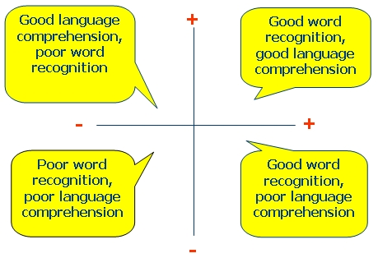

Slide 8
READING IN SCHOOL
Regular reading of high quality text types during English and also through other lessons.
Daily guided reading sessions (e.g. The Boy at the Back of the Class/ Wonder)
Excellent modelling of reading by teachers and TAs
Sharing a class book.
Reading comprehension tasks.
Reading interventions where appropriate.
Reading across other subjects such as humanities and science.
Library time.

Slide 9
HOME READING
Reading record and reading book.
Book bands.
Reading homework - At least 4 times a week.

Slide 10
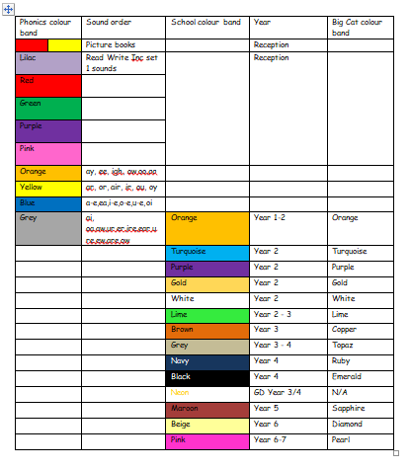

Slide 11
How you can help…
Parents, families and carers are the first educators of children and they are the key influence to developing a child’s learning (no pressure then!).
Home reading is an essential part of a child’s learning.
Setting routines and keeping to them offers your child a sense of security and helps them both at home and in school. Please help us develop your child’s reading by reading regularly with your child and supporting their home reading. 20 - 30 minutes every school day is ideal for Year 5/6
This then needs to be recorded in the child’s reading journal (either by you or your child). They must have their reading journals every day and they will be checked every week.

Slide 12
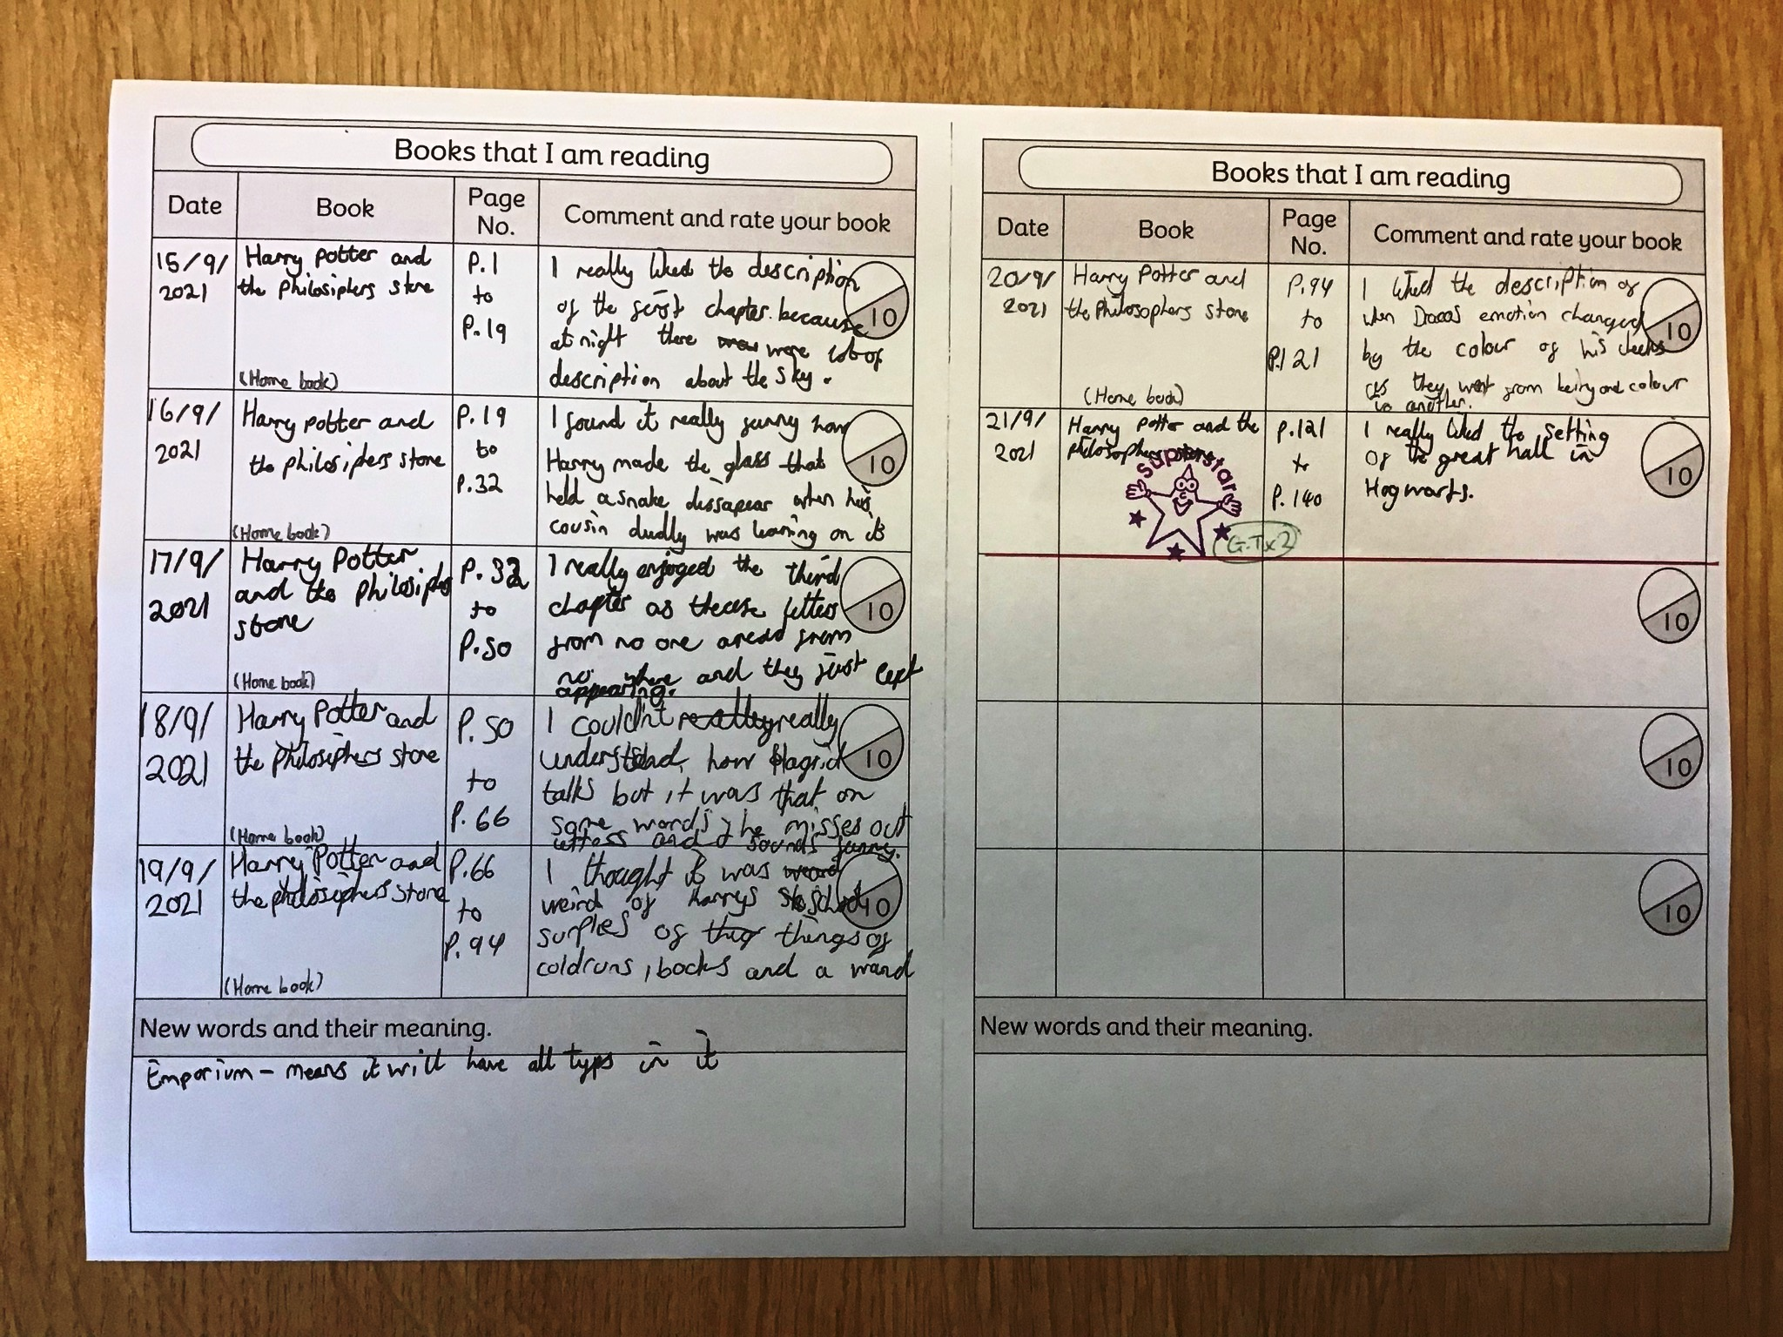

Slide 13
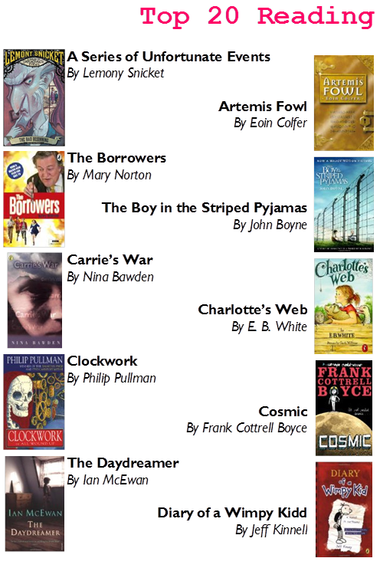

Slide 14
School Reading List
is a great website for books that are suited for each school year!

Slide 15
Writing

Slide 16
Y5 Writing
In Year 5

Slide 17
Y6 Writing
In Year 6 we use the expectations set for the end of KS2 to make our final judgement. They will be classified as..
Children are assessed at…
‘Working Towards’ (WT)
‘Working At’ (WA)
‘Working at Greater Depth’ (WGD)
It is important that they are able to show evidence for WT even though they may be able to reach targets in WA or WGD
Assessments linked to this will usually take place towards the end of a writing unit using our own assessment criteria linked to KS2 expectations.
Your child will have ‘cold’ writing assessments to complete throughout the year that will be moderated with other schools too.

Slide 18
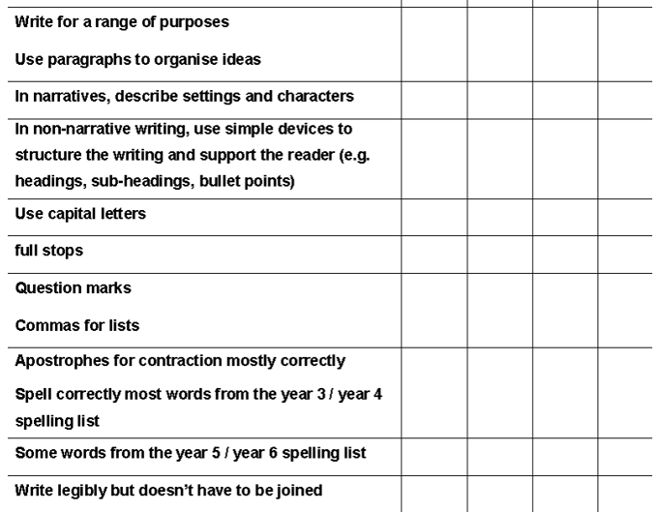
WT - Working towards the expected standard.

Slide 19
WA - Working at the expected standard.

Slide 20
WGD - Working at greater depth (beyond expected standard).

Slide 21
Spelling

Slide 22
Weekly Spellings
Children will be set 10 spelling words a week to practise.
In school, spellings will be practised daily in a variety of Spelling lessons that involve exploring the origin and definition of the week’s 10 words along with spelling patterns, syllables and other techniques to help the children take them on board.
Children will be tested each week on a Thursday and will then receive the next week’s 10 words.
Children will have access to Spelling Shed for further practise.

Slide 23
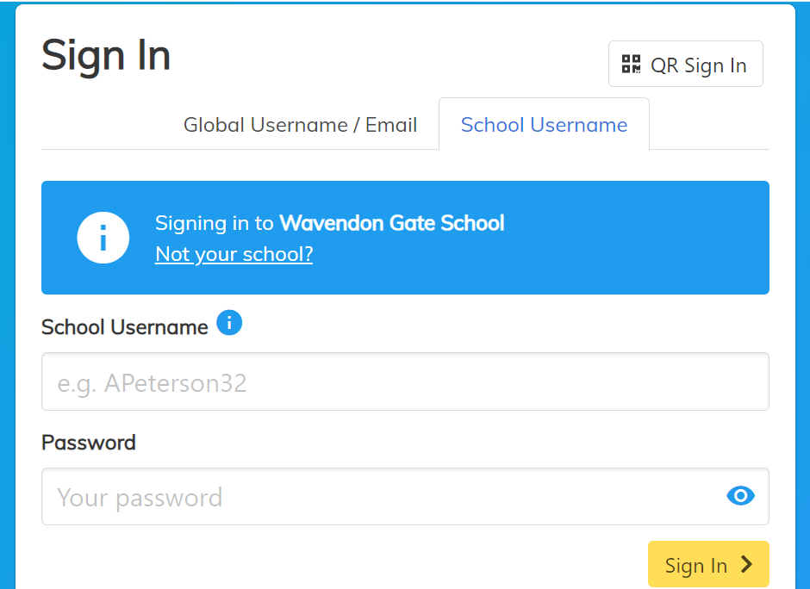
Spelling Shed
All children will have a login to Spelling Shed where they can complete weekly assignments set by their teacher. These assignments will involve playing a variety of games and puzzles to practise that weeks spellings.

Slide 24
Spelling help at home…
Encourage your child to use the spellings in a sentence.
See if they can write the word correctly at other times, in different contexts.
Helping them to learn and test spellings throughout the week.
Helping to spot patterns. If they know how to spell light then they can spell bright, sight, might…
Discussing words and patterns when they come up in ‘life’ experiences

Slide 25
Maths

Slide 26
Maths Curriculum
The curriculum in Maths has been designed with three main aims:
Fluency (arithmetic)
Reasoning
Problem solving

Slide 27
Maths Curriculum
The curriculum breaks mathematics up into the following areas:
Number:
Place value
Addition and subtraction
Multiplication and division
Fractions, decimals and percentages
Measurement
Geometry(Properties of shapes and position and direction)
Statistics

Slide 28
Times Tables Rockstars
All children will have a login to TTRockstars where they can complete various games and challenges to improve their fluency with times tables.
While times tables does not have as great a focus in Years 5 & 6 as it does in Y4 with the MTC it is still an essential part of UKS2 arithmetic.
Keeping this skill sharp is essential for Maths in Years 5 and 6 and some form of practise each week at home would be excellent if possible.

Slide 29
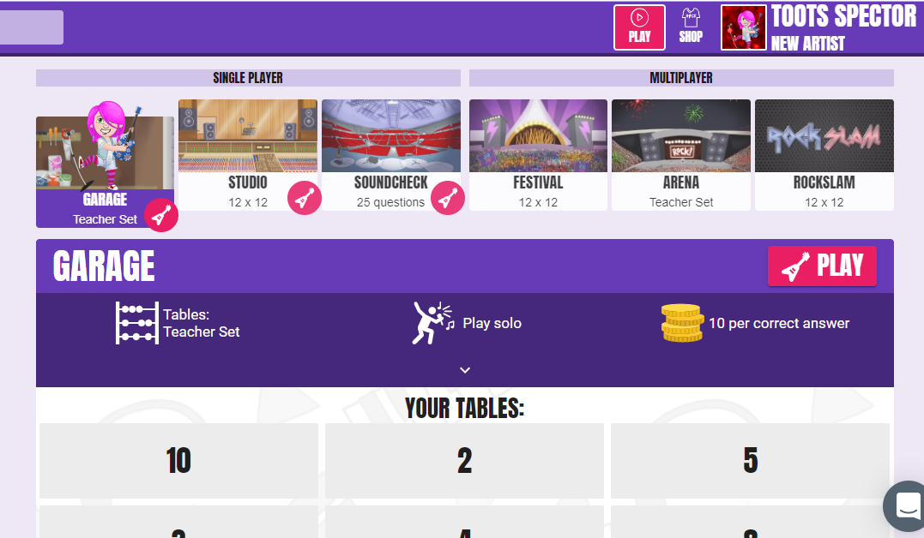
Times Tables Rockstars

Slide 30
Behaviour – “The Wavendon Gate Way”

Slide 31
Behaviour – “The Wavendon Gate Way”
The three ‘Rs’. Being…
Respectful – “please and thank you”, holding doors, looking after each other and property, walking around the school in silence…
Responsible – completing work on time, being organised / tidy, accepting responsibility, saying sorry…
Ready (to learn) – sitting silently, listening, giving the speaker 100% attention, working hard, being in the right place at the right time…

Slide 32
We have high expectations in Year 6 with regards to academic and social application.
Pupils are expected to show greater independence and responsibility for their learning and school life.
Rewards and Sanctions

Slide 33
Homework

Slide 34
Weekly Homework
Reading - At least 4 reads a week - Tracked and signed off in the child’s reading diary
Maths – Year 6 only. 2 Sheets of Maths linked with the week’s lessons. Given out on a Thursday and marked in class on the next Thursday.
Spellings – 10 words a week. Given out on a Thursday and tested on the next Thursday. Spelling Shed assignments to practise at home.
Times Tables – Times Tables Rockstar's

Slide 35
PLEASE EXPLORE THE SCHOOL WEBSITE FOR ADDITIONAL INFORMATION ON YEARS 5 AND 6.

Slide 36
Useful websites
https://www.mymaths.co.uk/
https://ttrockstars.com/
https://charanga.com/yumu/login
https://www.bbc.co.uk/bitesize
http://www.primaryhomeworkhelp.co.uk/
https://www.natgeokids.com/uk/
https://www.oxfordowl.co.uk/
https://www.topmarks.co.uk/
https://www.bbc.co.uk/bitesize/topics/zf2f9j6/articles/z3c6tfr

Slide 37
Thank you for listening
If you have any questions please feel free to ask me or your child’s class teacher.

