Slide 1
How to support your child at home
Year 3 and 4
September 2024

Slide 2
Aims of this session
To give you some ideas of ways to support and develop further learning at home.
To emphasise the importance of working as a team (child, parent/carer and teacher)

Slide 3
Year 3 and 4 Staff
Year 3 - Mrs Birch (3A), Miss Clairmonte (3B), Mrs Boseley and Mrs Sidat
Year 4 - Miss Miller (Phase Leader, 4B), Miss Verma (4A) and Mrs Parker

Slide 4
Reading
Reading is the most important skill we teach and is life changing!
Reading skills are taught during guided reading sessions and pupils frequently practise their reading skills in all subjects across the curriculum.
Homework - Reading at home 4 times a week
Notes:
Why is reading important?
Reading is an integral part of our school curriculum and impacts on all other learning. It is through reading that children develop a wide vocabulary and are able to confidently access the rest of the curriculum.
But most important of all – reading opens the children's minds to new ideas, to the world around us and the pleasure of the written word in stories and poems.

Slide 5
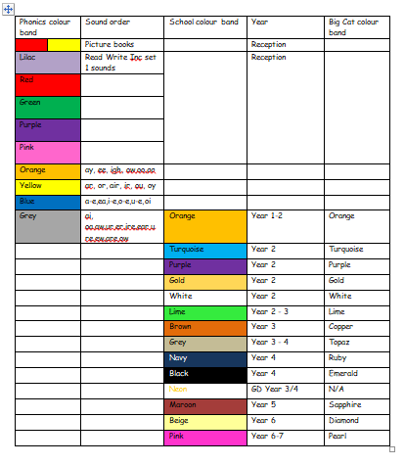
Book Bands
Notes:
All of our books are arranged into colours dependent on their difficulty (phonics books) and age appropriateness (orange colour onwards). Books get longer in length as the pupils move through the bands and pupils are expected to read a broad range of books in each colour (fiction, non fiction and poetry).

Slide 6
Tips for hearing your child read.
Find time to enjoy reading together
It’s really important for children to frequently practise reading aloud and enjoy stories. If they are tired, consider reading to your child instead.
Find emotion within the book
Find emotion within the book, if the characters within the story are happy, sad or angry for instance, talk about the emotions portrayed and find out the reader’s personal point of view. Look at the language used to portray these emotions.
Read aloud to others
Children should read aloud to others on a regular basis, either to brothers and sisters, grandparents and other relations and friends. This improves their confidence and they begin to recognise and “tune in” to their own reading aloud voice. This is proven to improve confidence in reading.

Slide 7
Ask questions
The magic words HOW, WHAT, WHERE, WHEN AND WHY when applied to different questions about the child’s reading material help the child to develop comprehension of the text, whether it be fiction or non-fiction.
Stop and review words
Stop and review or explain words within the text. Find the time to look them up in dictionaries and explain their meaning within the context of the story.
If your child is a reluctant reader, try not to ask them questions about the book they are reading and just enjoy listening to them read or consider reading to them to mix things up a bit and keep reading an enjoyable experience!

Slide 8
Reading at home …
Reading record and reading book
A colour band is stuck on the spine which indicates your child’s current reading level. The children are assessed using an on-line tool measuring accuracy, fluency and comprehension. This is in addition to reading tests and teacher judgements.
Children are expected to read a range of fiction, non fiction and poetry books before moving onto another book band.
School expectations are that pupils read at home at least 4 times a week to support their reading lessons in school. This should be for at least 20 minutes during these independent reads.
Notes:
Introduce the recommended reads booklets for parents to take away with them. Spare ones will be stored in the reception area for parents not at today’s meeting.

Slide 9
Spellings
Spellings are set weekly.
Spelling Shed is our new online spelling curriculum.
Logins for Spelling Shed can be found in your child’s reading journal.
Pupils are tested weekly on a random selection of the words learnt during the week.
Spelling tests are THURSDAYS.
Notes:
Spellings are set weekly following the national curriculum statutory requirements. This year we will be using an online spelling programme called Spelling Shed which also contains games that the children can play to support their learning at home.
Each week, in their spelling lessons, pupils learn about a particular combination of letters or a spelling rule and are tested on a random selection of the words learnt at the end of the week.

Slide 10
Spelling at home …
Encourage your child to use the spellings in a sentence.
See if they can write the word correctly at other times, in different contexts.
Helping them to learn and test spellings throughout the week.
Helping to spot patterns. If they know how to spell light then they can spell bright, sight, might…
Discussing words and patterns when they come up in ‘life’ experiences

Slide 11
Grammar
Grammar is taught in English lessons but referred to in all subjects.
Tenses
Word classes
Simple, compound and complex sentences
Expanded noun phrases
Fronted adverbials
Direct and reported speech
As you can see there are lots of rules regarding the use of grammar.
The children will learn how to plan their writing to be clear, simple and concise.
They will refine their skills in planning, using paragraphs and proof reading their work in order to identify any mistakes.
Notes:
Grammar is taught in English lessons but referred to in all subjects.
But what is grammar?
Grammar is the study of the way words are used to make sentences. In Year 4, we are building on our knowledge of sentences to include fronted adverbials and learning to recognise more types of words used in a sentence like pronouns, determiners and adverbials.
Parents can support this at home by correcting incorrect grammar in spoken language such as using the correct tense. You can also encourage your child to write at home and practise the skills that they have been learning.

Slide 12
Maths
We use a Mastery approach to teaching mathematics at Wavendon Gate School.
Remember to keep revisiting times tables at home and quick recall arithmetic questions as this will help them to solve more complicated problems throughout the year.
Notes:
At Wavendon Gate School we use a Mastery approach to teaching maths. This means that all of our lessons have a tight learning focus, are taught through a range of approaches and allow for all pupils to become ‘more expert.’ We will be covering all four operations in more depth as well as learning more about statistics, fractions and geometry.
We want our pupils to become fluent mathematicians who are capable of applying their understand and reasoning in context. That said speed and accuracy will always be crucial elements of maths.
To help your child at home, it is still recommended to keep revisiting times tables and other quick recall arithmetic questions. This could take place in the home, in the car or when out and about. In addition, asking your child to explain their method allows them to share their learning and reasoning. The use of deliberate mistakes for children to correct allows them to position themselves as the expert and prove that you are wrong. They might even enjoy assisting you to correct your work!

Slide 13
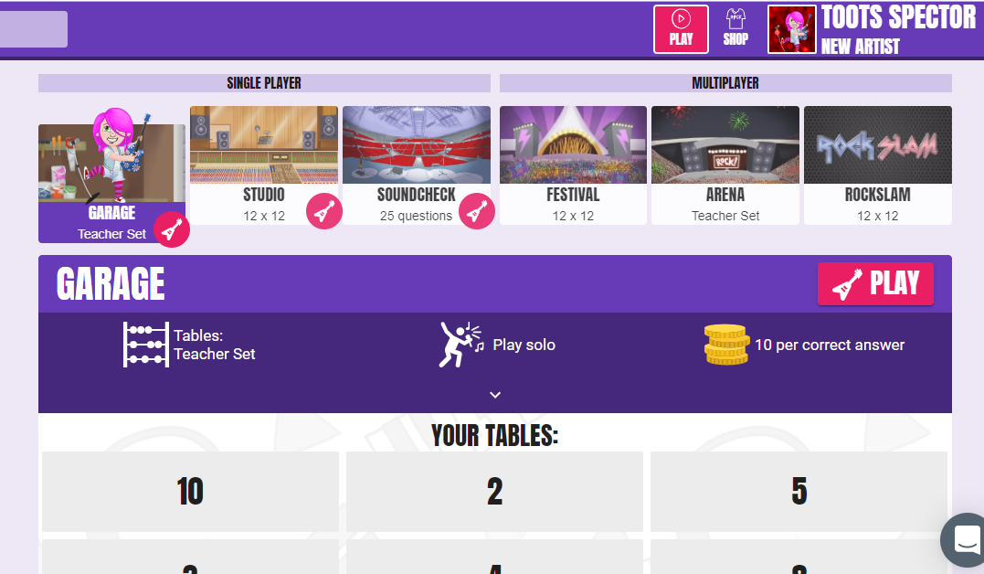
TT Rockstars
Notes:
Login details are kept in the front of pupils’ reading diaries.

Slide 14
Remote Learning
Google Classroom online programme
Work set by 9am on the second day of a child’s absence
English, Maths and 1 other subject
Pupils are also expected to continue their home reading, times tables and spelling work.
Notes:
If a pupil is absent with a contagious illness but is well enough to work, work is set for them to complete at home at parent’s request. You know if your child is well enough to complete work so we ask for you to email admin@wavenongateschool.co.uk to request it. If a child is poorly, then they should be resting rather than completing work as this could hinder their recovery.

Slide 15
Behaviour – “The Wavendon Gate Way”
The three ‘Rs’. Being…
Respectful – “please and thank you”, holding doors, looking after each other and property, walking around the school in silence…
Responsible – completing work on time, being organised / tidy, accepting responsibility, saying sorry…
Ready (to learn) – sitting silently, listening, giving the speaker 100% attention, working hard, being in the right place at the right time…

Slide 16
The Wavendon Gate Way
FANTastic walking
Facing forwards At a steady pace Neat single file Total silence

Slide 17
The Wavendon Gate Way
FANTastic listening
Facing forwards hands together Always sit up straight Never interrupt Track the speaker

Slide 18
Parent Workshops
Parent workshops happen once every half term on a Friday. There is a preceding assembly by the teacher who leads that subject.
You are then invited to visit your child’s classroom and participate in activities linking to your child’s topics at the time. This is a great opportunity to look through your child’s books.

Slide 19
Useful websites
Some other websites to explore:
Maths: https://ttrockstars.com/
https://www.bbc.co.uk/bitesize
https://www.sumdog.com/
https://www.topmarks.co.uk/
https://mathszone.co.uk/
Humanities
https://www.bbc.co.uk/bitesize
https://kids.nationalgeographic.com/
http://www.bbc.co.uk/history/forkids/
Poetry and reading
https://home.oxfordowl.co.uk/
https://www.booktrust.org.uk/books-and-reading/have-some-fun/storybooks-and-games/
https://stories.audible.com/discovery
https://www.poetrybyheart.org.uk/
Notes:
Heere are some links that relate to different subjects that may further enhance your child’s learning

